Slide 1

TriFuse-xNet: Bridging the Generalization Gap in Breast Cancer Histopathology via
Explainable Hybrid Fusion
Course Name: Knowledge-Based Systems
Section: A [MScCS]
Faculty:
Presented By
Asmaul Hossain Akash (25-93883-3)
American International University – Bangladesh (AIUB)
Notes:
Good evening, everyone, I am Asmaul Hossain Akash, welcome to my presentation based on deep learning in medical imaging. In this presentation, I am going to introduce a new hybrid fusion model named TriFuse-xNet, which bridges the generalization gap in breast cancer histopathology via explainable hybrid fusion. So, let's get started.

Slide 2
List of Contents
Introduction & Motivation
Literature Review & Research Gaps
Methodology & Proposed Architecture
Datasets & Experimental Protocols
Results: Generalization & Performance
Explainable AI (XAI) Analysis
Conclusion & Future Directions

Slide 3
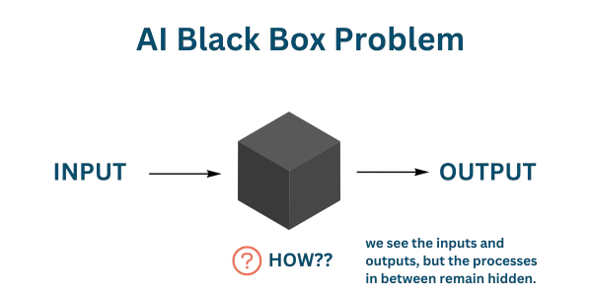
• The Clinical Bottleneck:
• Histopathology is manual, subjective, and time-intensive.
• Goal: AI to assist pathologist, not just classify images.
• The Critical Failure of Current AI:
• Trust Deficit: "Black-Box" models offer no explanation.
• Generalization Gap: High lab accuracy ≠ Real-world performance.
• Our Objective:
• To move beyond Lab Accuracy toward Clinical Robustness.
• Build a system that is:
1. Transparent (Explainable via XAI)
2. Transferable (Generalizable to new hospitals)
Introduction & Motivation
Notes:
First, let's look at The Clinical Bottleneck. While Histopathology remains the gold standard for cancer detection, but it is manual, subjective, and incredibly time-intensive. Our goal is not to replace pathologists, but to create an AI assistant that reduces their workload and variability.
However, we face a Critical Failure in Current AI. If you look at the diagram on the right, you see the 'Black Box Problem'. Most state-of-the-art models take an input and give an output, but the process in between remains hidden. This creates a Trust Deficit—clinicians cannot trust a diagnosis if the model offers no explanation.
Furthermore, there is a Generalization Gap: We often see models achieve 99% accuracy in the lab, but when tested on data from a different hospital, their performance crashes. This gap between 'Lab Accuracy' and real-world performance is dangerous.
This brings us to our objective: We need to move beyond simple accuracy metrics. Our research aims to build a system that is Clinically Robust. It must be Transparent—showing us where it is looking—and Transferable, meaning it works reliably across different datasets and hospitals.

Slide 4
Related Work & Research Gaps
• Current Approaches:
• Standard CNNs (ResNet, VGG): High internal accuracy but poor generalization [Rafiq et al.].
• Vision Transformers (ViT): High performance but computationally expensive & data-hungry [Gella et al.].
• Existing Hybrids: Often lack rigorous external validation (Zero-shot testing)
• The Unsolved Gap:
• Existing studies focus heavily on Lab Metrics.
• Lack of models that are simultaneously accurate, generalizable to new datasets, and explainable.
Notes:
In related works we can see significant gaps remain in the current literature.
First, we have standard CNNs like ResNet and VGG. While papers by Rafiq and others show they achieve high internal accuracy, they often fail to generalize when tested on new data.
Second, we have Vision Transformers. As Gella and others demonstrated that these are powerful, but they are incredibly data-hungry and computationally expensive, making them difficult to deploy in clinical settings.
Finally, existing hybrid models often skip the hardest test: that is external validation.
This leaves a clear Unsolved Gap: The field is flooded with papers focusing on 'Lab Metrics.' What is missing is a single framework that is simultaneously Accurate, Generalizable to new hospitals, and Explainable to doctors. That is the specific gap that our work addresses

Slide 5
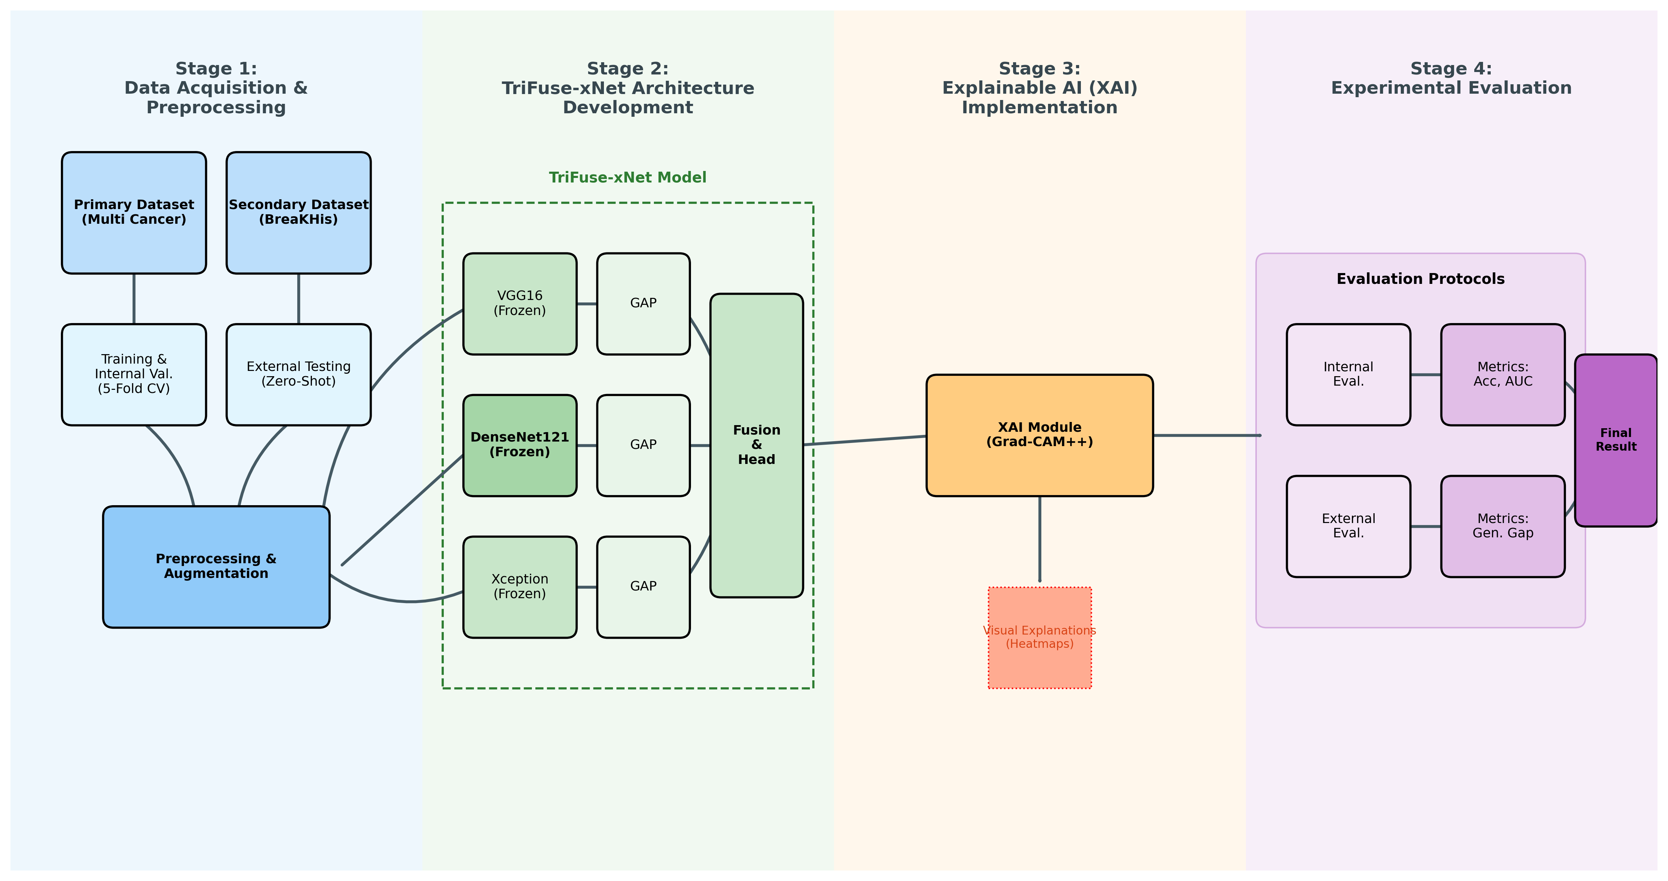
Methodology
• Stage 1 Data Preparation: Primary & Secondary Dataset (BreaKHis)
• Stage 2 Feature Extraction: Parallel extraction using Multiple Model
• Stage 3 Hybrid Fusion: Concatenation → Dense Layer → Sigmoid Output.
• Stage 4 Evaluation: Zero-Shot Testing & XAI Analysis.
Notes:
To address the gaps we identified, we designed a comprehensive four-stage pipeline.
Stage 1 involved preparing two distinct datasets: one for training and a completely separate one for 'zero-shot' testing.
In Stage 2, we didn't rely on a single model. Instead, we implemented parallel feature extraction using multiple architectures.
Stage 3 is our core contribution: a Hybrid Fusion mechanism that concatenates these features before classification.
Finally, Stage 4 focused on diverse evaluation, using both XAI analysis and external testing to prove robustness."

Slide 6
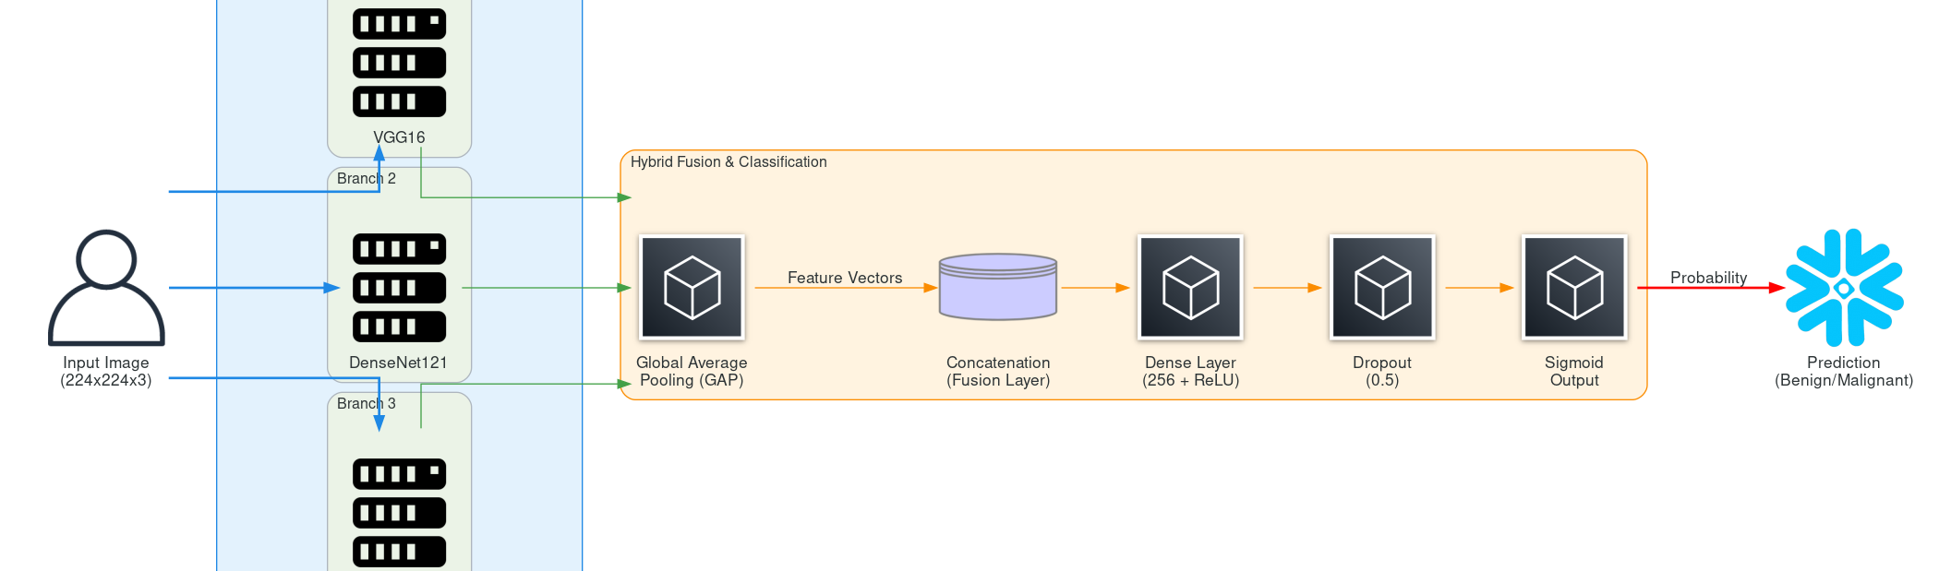
Proposed Architecture: TriFuse-xNet
The Power of Three Fusion
• VGG16: Captures low-level textural patterns.
• DenseNet121: Deep semantic features via feature reuse.
• Xception: Spatial correlations via depthwise separable convolutions.
• Fusion Strategy: Combines distinct inductive biases (Texture + Semantics + Spatial).
Notes:
Let’s look at the core of our solution: TriFuse-xNet. We selected three specific backbones for their complementary strengths:
VGG16 captures the low-level textural patterns of the tissue.
DenseNet121 provides deep semantic features through efficient feature reuse.
Xception handles spatial correlations using depthwise separable convolutions. By fusing these diverse 'viewpoints,' our model stops relying on specific artifacts and learns a truly robust representation of the cancer.

Slide 7
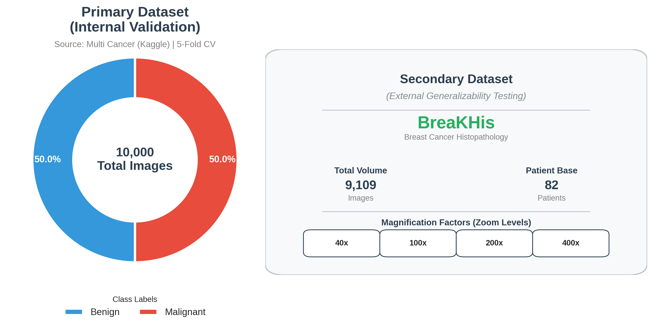
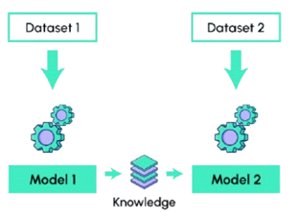
Datasets & Experimental Protocols
Primary Dataset (Training):
Source: Multi Cancer Dataset (10,000 images).
Role: Training & Internal Validation (5-Fold CV).
Secondary Dataset (Testing and Validating):
Source: BreaKHis (~9,000 images).
Role: Zero-Shot Evaluation.
    Strictly unseen data.
    Purpose: To test true Clinical Robustness.
Notes:
In Our experiment We trained the model strictly on the Multi Cancer Dataset using 5-fold cross-validation. However, for testing and validating, we did not use the same source. Instead, we used the BreaKHis dataset in a 'Zero-Shot' setting. This means the model never saw this data during training. This is the ultimate test of whether a model has truly learned pathology or just memorized a specific dataset's style.

Slide 8
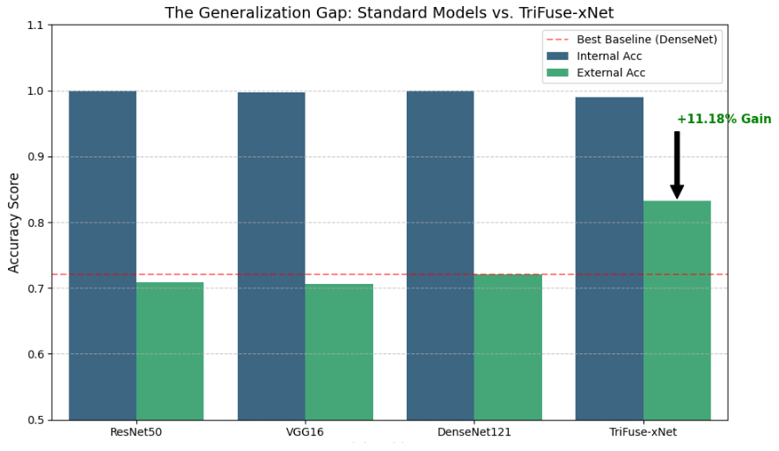
Key Result: Bridging the Generalization Gap
Baseline Performance:
Internal Accuracy: >99% (High Overfitting Risk).
External Accuracy: Drops to ~70%.
Gap: ~29% performance loss.
TriFuse-xNet Performance:
External Accuracy: 83.26% (+11.18% gain).
Gap: Reduced to 15.74%.
We reduced the generalization gap from ~29% to 15.74%
Notes:
This is the most critical finding of our research. If you look at the Blue bars, you see that every model performs nearly perfectly on internal data. This is misleading. The Green bars reveal the truth. When exposed to external data, standard baselines like ResNet and VGG crash, losing nearly 30% of their accuracy. TriFuse-xNet, holds strong. We achieved an external accuracy of 83.26%, effectively cutting the generalization gap in half and outperforming the best baseline by over 11%

Slide 9
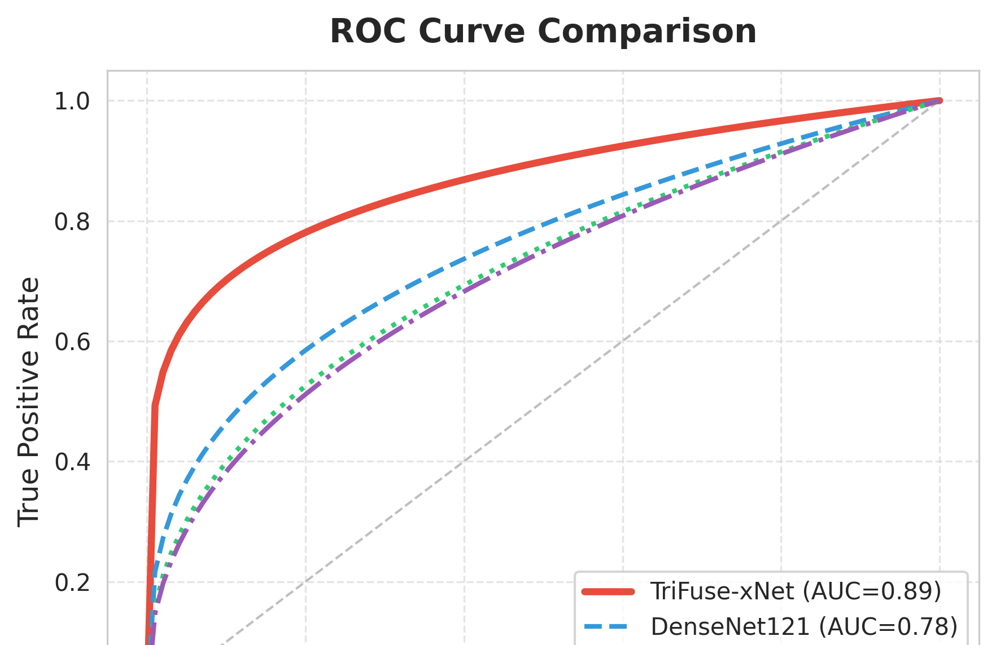
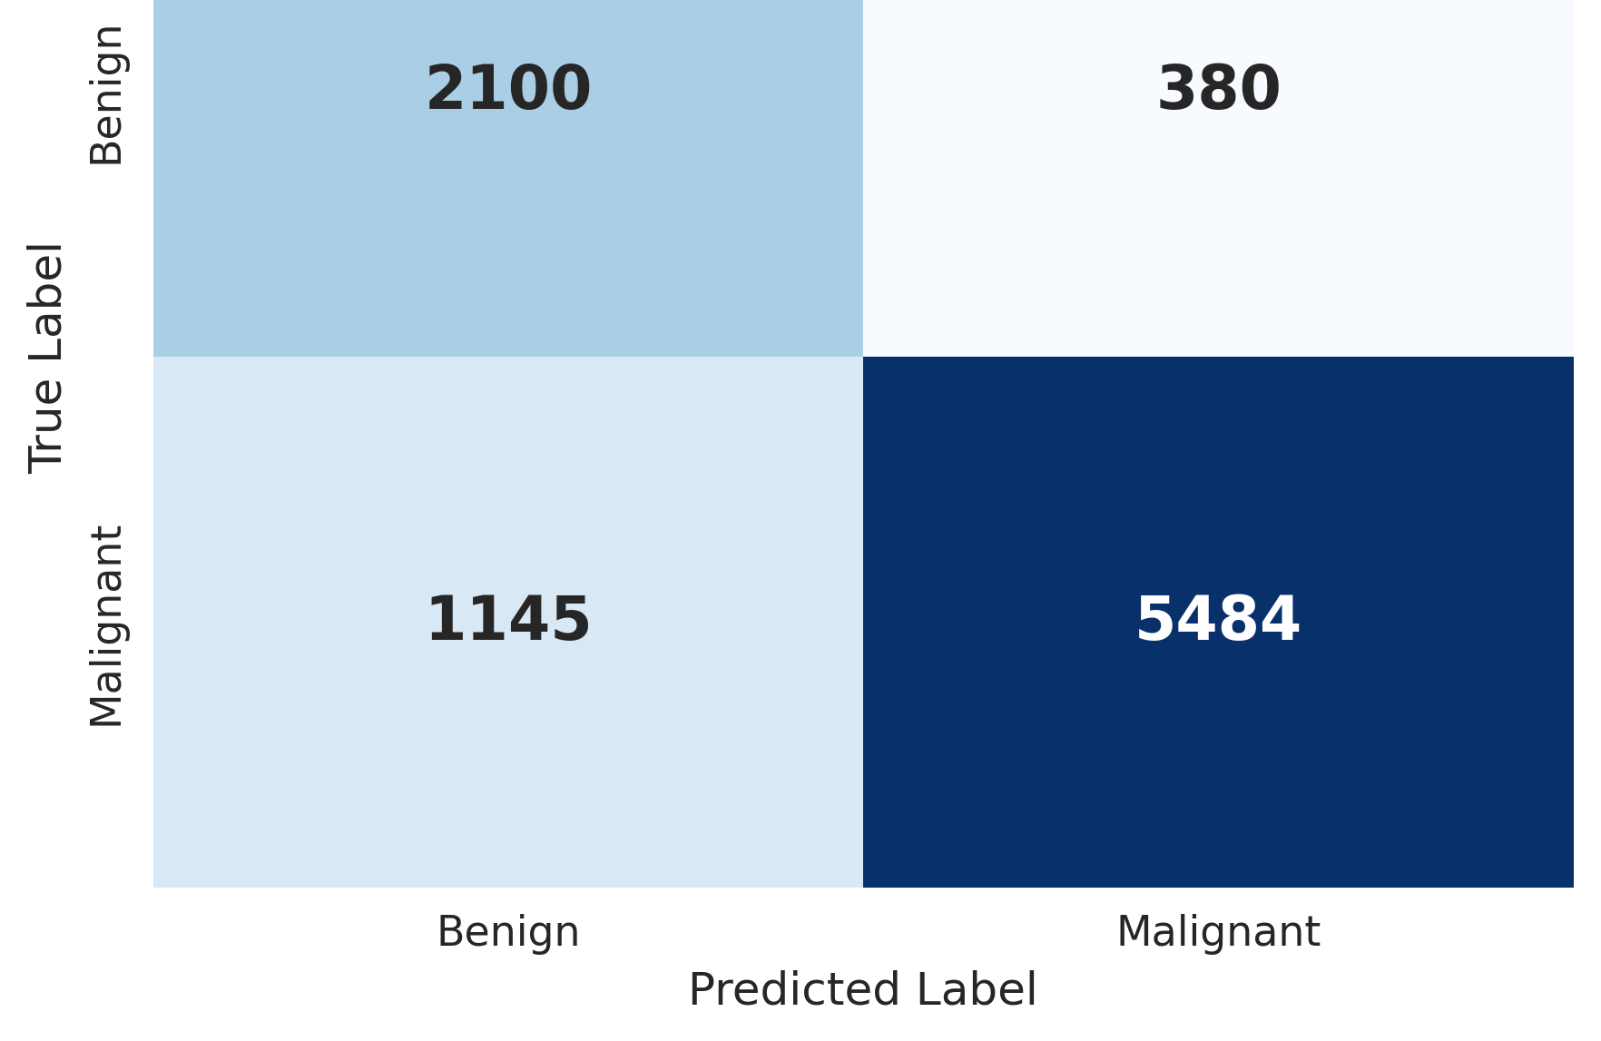
Performance Metrics
Highlights
  Confusion Matrix: High True Positive rate on external data.
  ROC Curve: TriFuse-xNet (Red line) has the highest AUC (0.89), outperforming DenseNet (0.78)
  Improvement: +11.18% accuracy gain over the best baseline.
Notes:
To really understand the quality of our model's predictions, let's look at the specific metrics on the external dataset.
First, on the left, we have the ROC Curve. Please focus on the solid Red line. This represents our TriFuse-xNet. Notice how it achives significantly higher than the dashed blue line, which represents the best baseline, DenseNet121. We achieved an AUC of 0.89 compared to their 0.78, which statistically proves our model has superior sensitivity and specificity.
On the right, the Confusion Matrix validates this performance in absolute numbers. Despite this being 'zero-shot' external data, the model correctly identified 5,484 malignant cases, maintaining a very high True Positive rate.
The Bottom Line: When we combine these metrics, we see that our hybrid approach didn't just pass the competition—it delivered a solid 11.18% improvement in overall accuracy over the best-performing baseline.

Slide 10
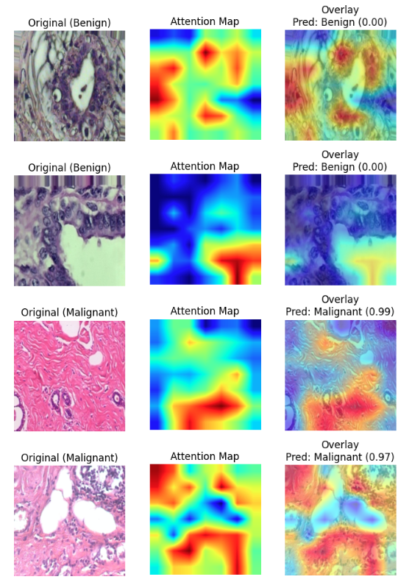
Qualitative Analysis: Explainable AI (XAI)
Technique: Grad-CAM++
Visual Evidence:
  Benign Samples: Model attends to broad tissue structures.
  Malignant Samples: High activation (Red) strictly on hyperchromatic nuclei.
Clinical Significance:
  Model ignores background artifacts.
  Decision logic aligns with pathological diagnostic criteria.
Notes:
numbers alone don't build trust. We needed to know what the model was looking at. Using Grad-CAM++, we generated these heatmaps. As you can see in the malignant samples, the model ignores the background and focuses its attention strictly on the hyperchromatic nuclei and irregular cell clusters. This confirms that TriFuse-xNet is making decisions based on actual, clinically relevant pathological features.

Slide 11
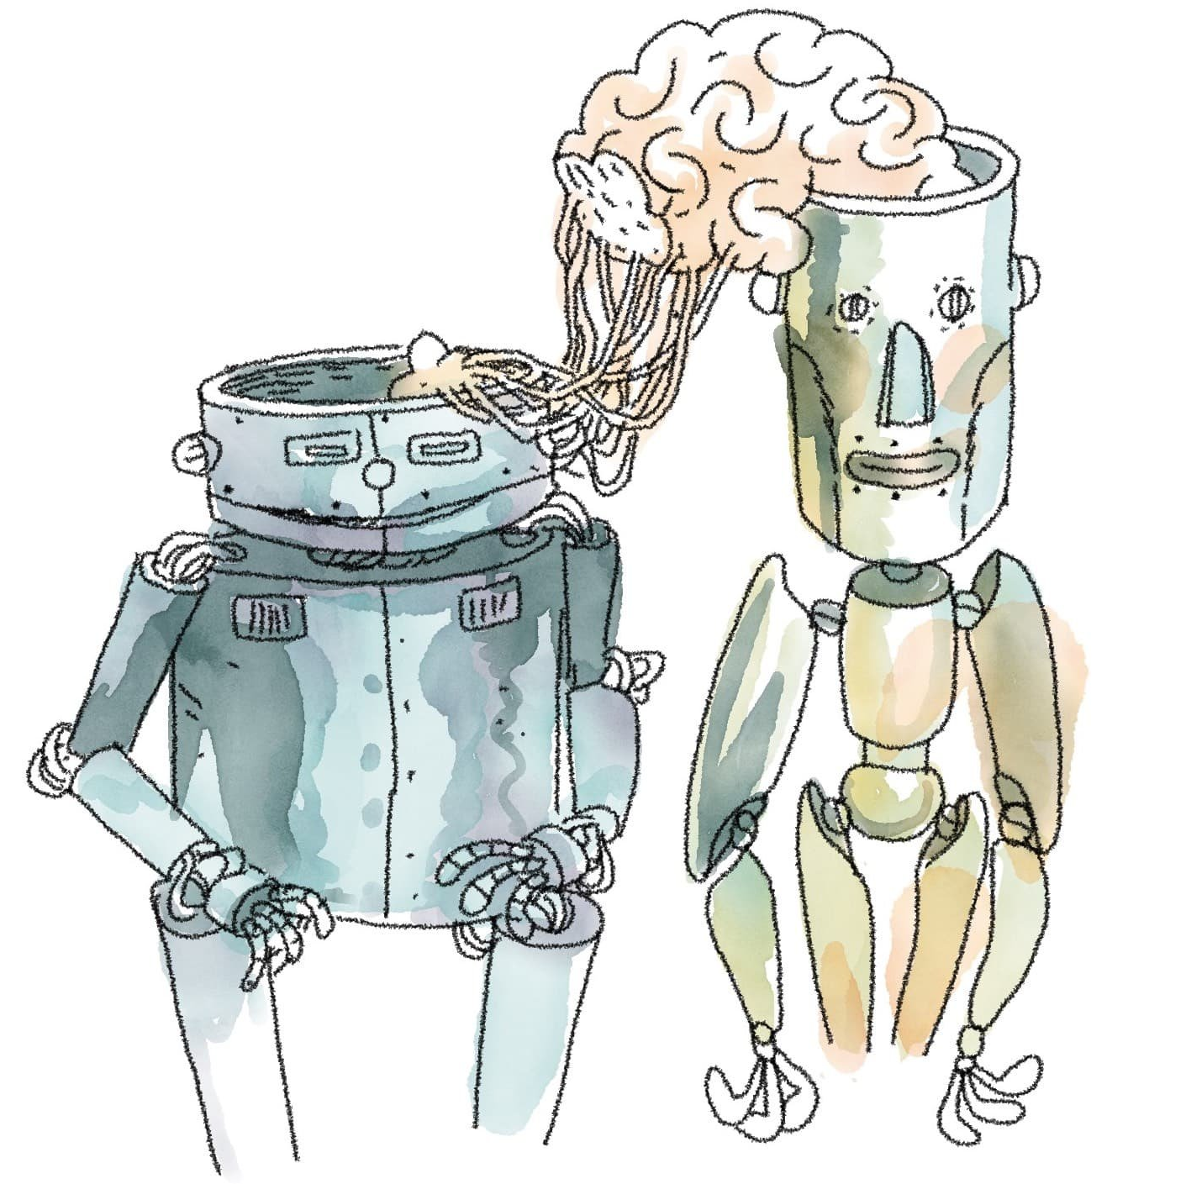
Conclusion & Future Directions
Summary:
  Success: Developed TriFuse-xNet (Hybrid Fusion).
  Robustness: Achieved 83.26% external accuracy.
  Trust: Established transparency via XAI.
Future Work:
  Extend framework to Whole Slide Images (WSI).
  Integrate Vision Transformers (ViT) for global context capture.
  Conduct prospective studies with pathologists in the loop.
Notes:
In conclusion, we have successfully developed TriFuse-xNet, a hybrid framework that bridges the gap between lab accuracy and clinical utility. We proved that by fusing complementary features, we can achieve superior robustness on unseen data while maintaining transparency through XAI. Our next step is to scale this architecture to handle Whole Slide Images and integrate Vision Transformers, moving us one step closer to an AI assistant that clinicians can fully trust.

Slide 12
Thank you
In conclusion, Hybrid fusion is significantly more stable across domains.

Slide 13
References
A. Rafiq, A. Jaffar, G. Latif, S. Masood, and S. E. Abdelhamid, ”Enhanced multi-class breast cancer classification from whole-slide histopathology images using a proposed deep learning model,” Diagnostics, vol. 15, no. 5, Art. no. 582, 2025.
V. Gella, ”High-performance classification of breast cancer histopathological images using fine-tuned vision transformers on the BreakHis dataset,” bioRxiv, preprint, Aug. 2024. doi: 10.1101/2024.08.17.608410.
Y. Zou and P. Miao, ”Explainable AI-enabled hybrid deep learning architecture for breast cancer detection,” Frontiers in Immunology, vol. 16, 2025. doi: 10.3389/fimmu.2025.1658741

